Slide 1
Tracheostomy Problem Solving for First Responders
Julia Ruth, M.Ed SLP
Tara Webb, RRT

Slide 2
Introduction
Julia Ruth is a full time Speech-Language Pathologist at St. David’s Medical Center
Tara Webb is an educator and supervisor of Respiratory Therapy at St. David’s Medical Center

Slide 3
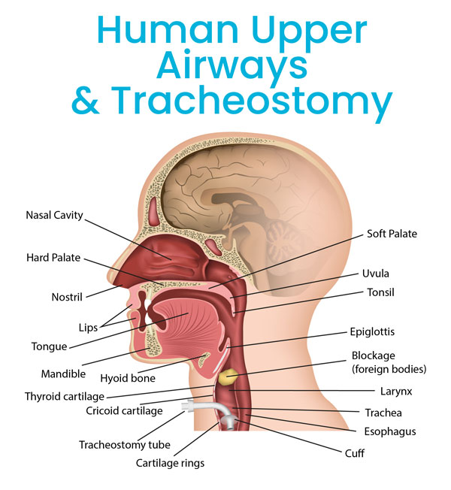
Overview
What is a trach?
Who receives trachs?
Why do people keep trachs?
What are the parts of a trach?
Problem solving with trach tubes
Case study [removed from this copy for patient privacy]
Hands-on applications

Slide 4
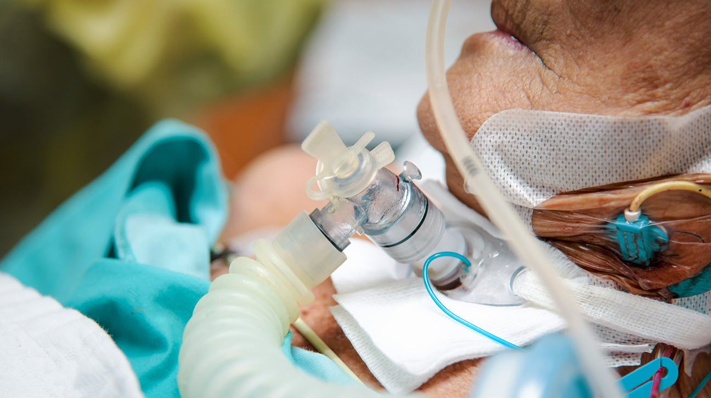
What is a tracheostomy tube?
A tracheostomy tube is a semi-permanent artificial airway used in patients with compromised respiratory systems.

Slide 5
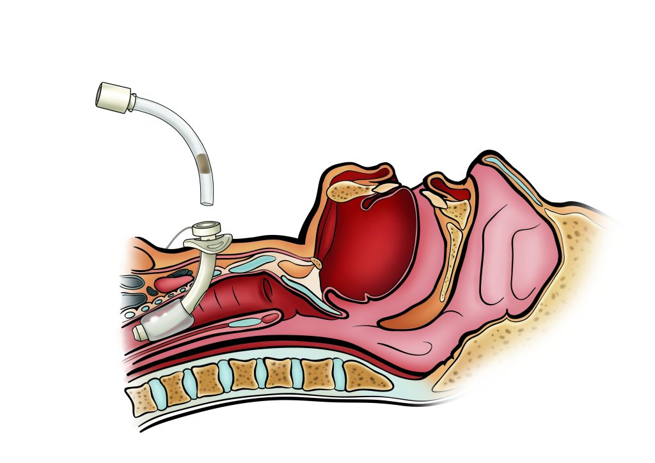
Who receives tracheostomy tubes?
10-24% of ventilated adult patients receive tracheostomy tubes (Watters, 2017)
Average of 84,762 tracheostomy tubes placed per year between 2002-2014 and 2016-2017 (Abril et al, 2021)

Slide 6
Why do people keep tracheostomy tubes?
Many (but not all) patients with tracheostomy tubes are decannulated in acute care or post acute care environment
Two categories: physiological and anatomical
Physiological examples: impaired respiratory system (ie ARDS, cardiopulmonary disease), impaired central nervous system (ie spinal cord injury, degenerative disease, CVA)
Anatomical examples: stenosis (tightening), mass, abnormal anatomy, malacia, craniofacial anomalies (ie Treacher Collins)
*Some patients retain trachs for both physiological and anatomical reasons

Slide 7
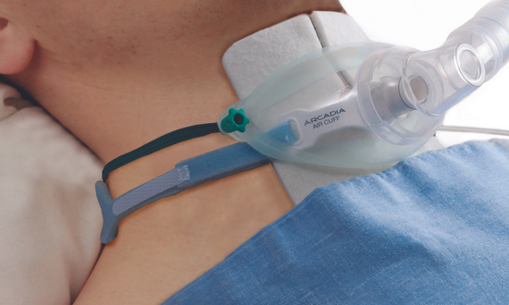
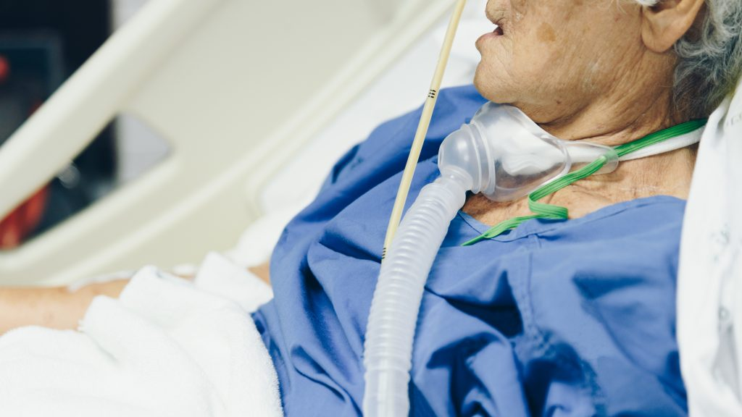
Modes of oxygen delivery: trach collar/trach mask
OPEN circuit
(air can escape)

Slide 8
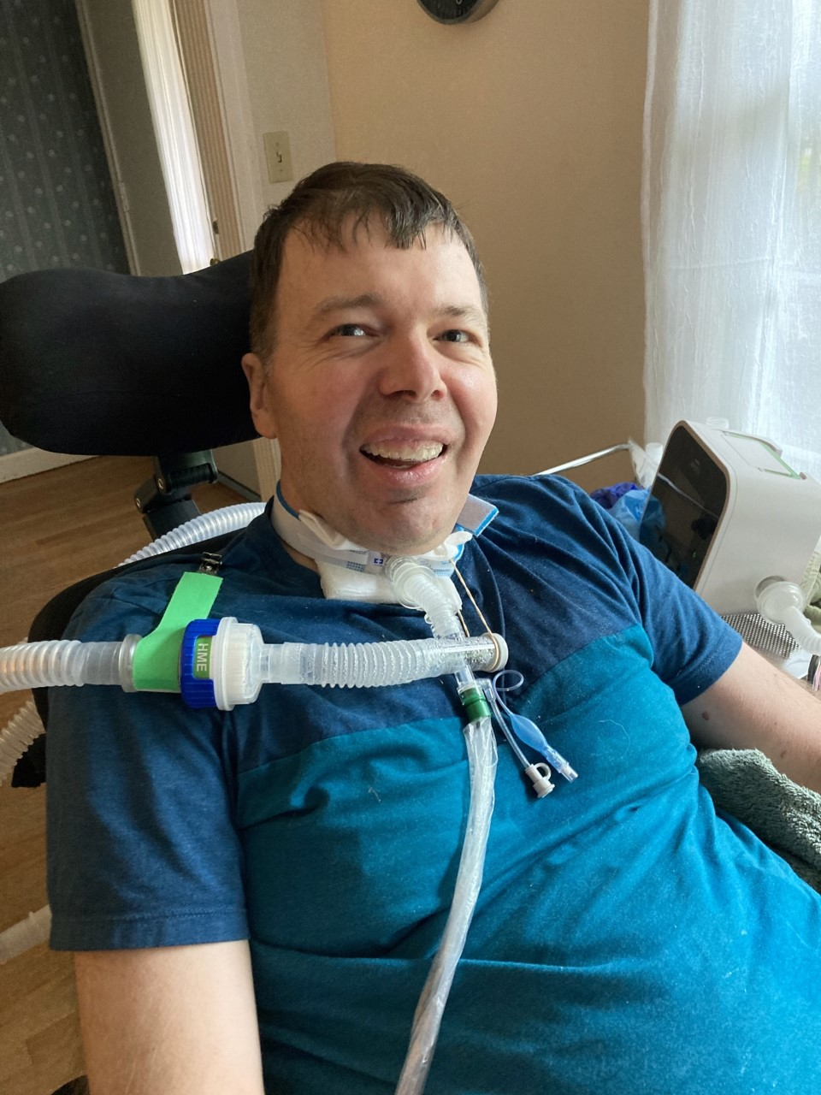
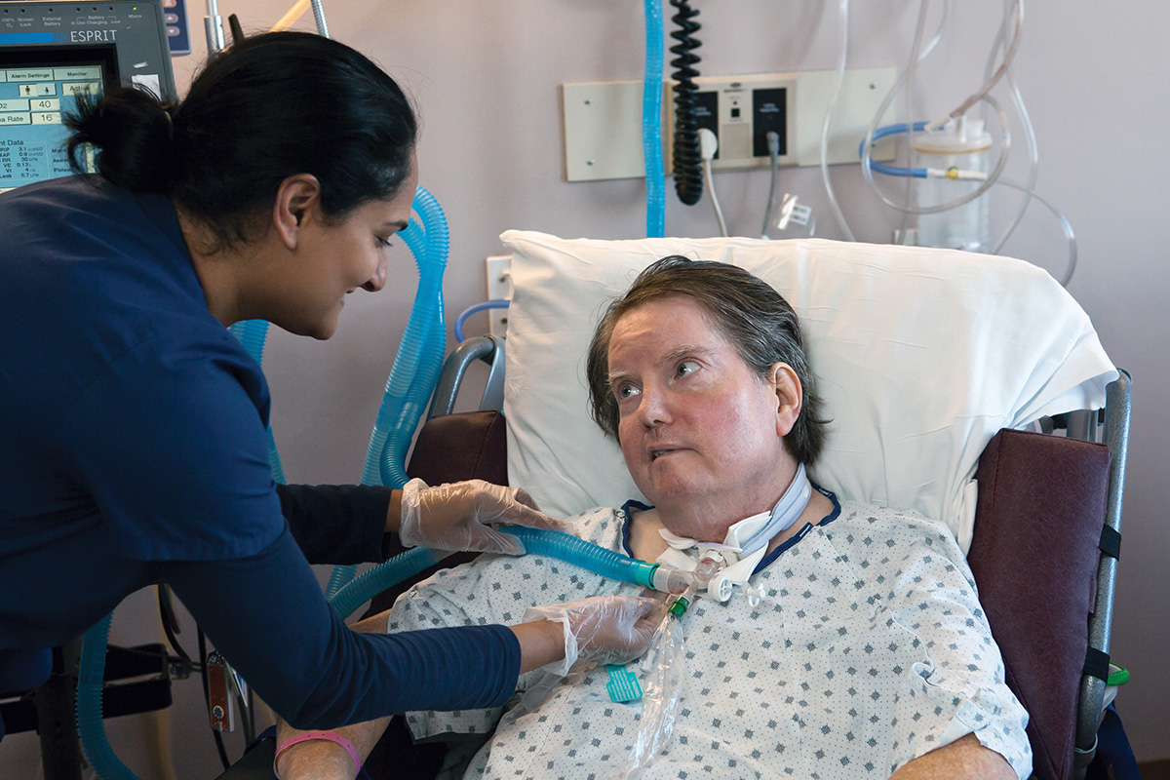
Modes of oxygen delivery: vent/BiPAP/CPAP
CLOSED circuit (air should not escape)

Slide 9
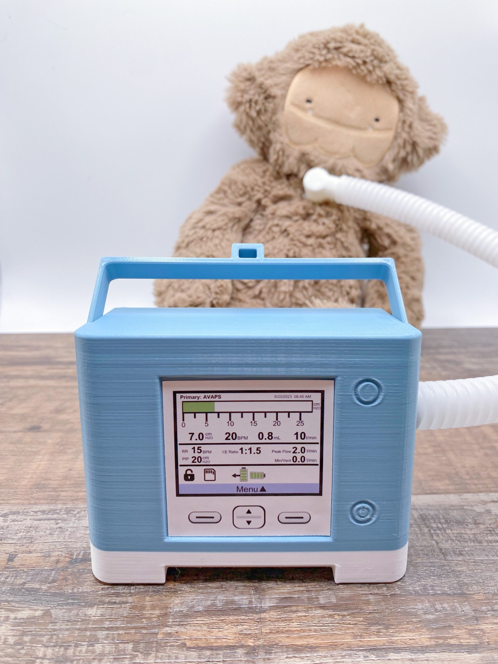
Modes of oxygen delivery: Trilogy

Slide 10
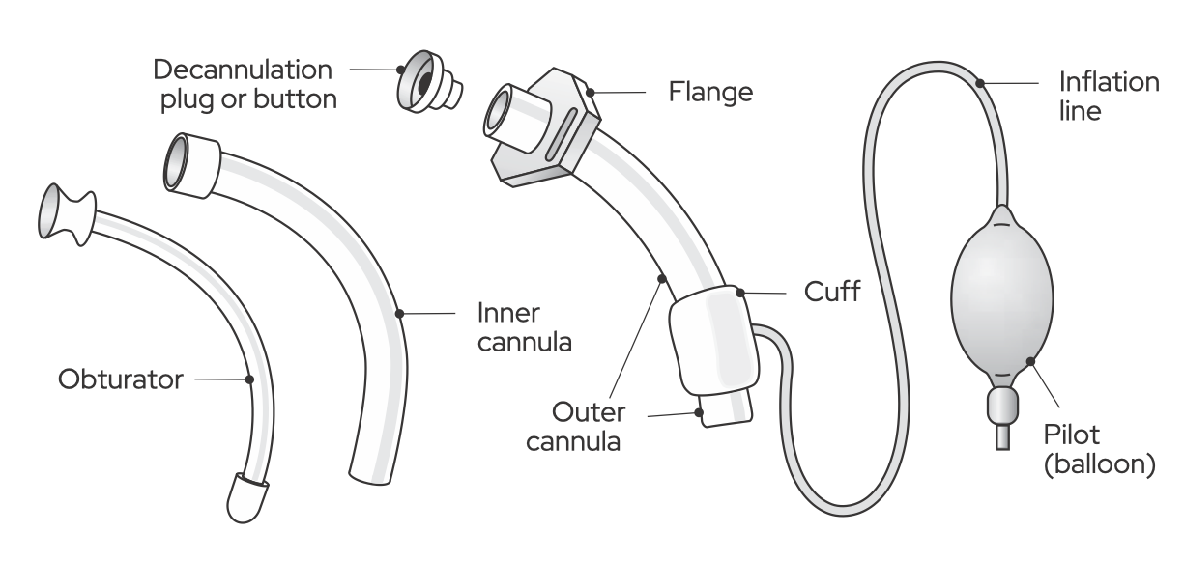
Tracheostomy tube components
Source: ASHA tracheostomy and ventilator dependence
https://www.asha.org/practice-portal/professional-issues/tracheostomy-and-ventilator-dependence/

Slide 11
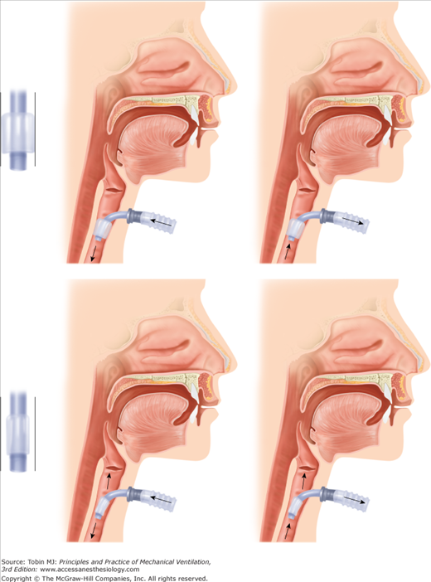
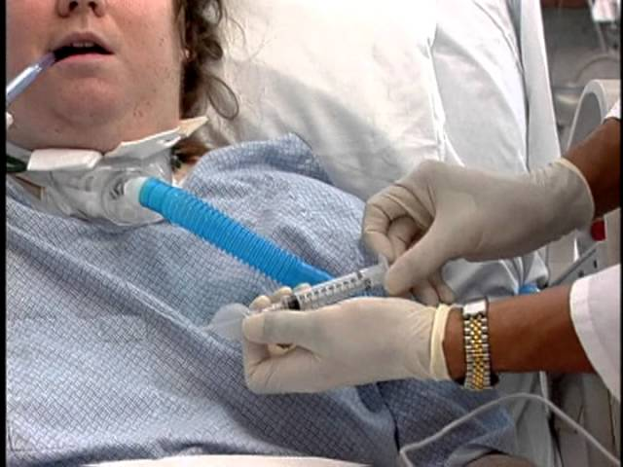
What is a cuff?
Cuff creates a CLOSED CIRCUIT loop
Cuff deflation allows for air escape
How to check if cuff inflated: check pilot balloon! (inflated pilot balloon = inflated cuff)

Slide 12
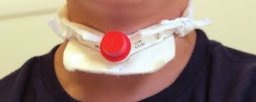
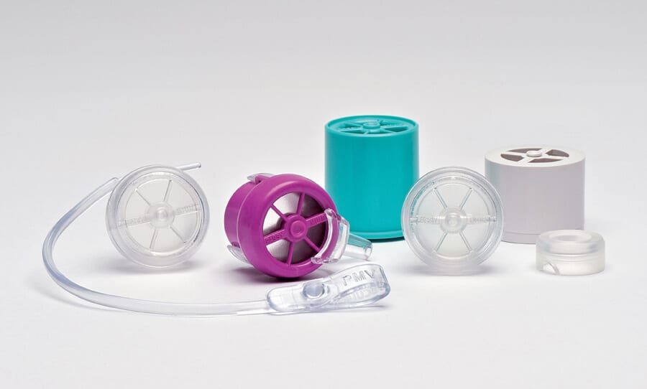
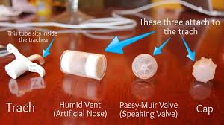
Trach caps, HMEs, PMVs
Key point: if one of these is on the trach, and pt is in respiratory distress, TAKE IT OFF

Slide 13
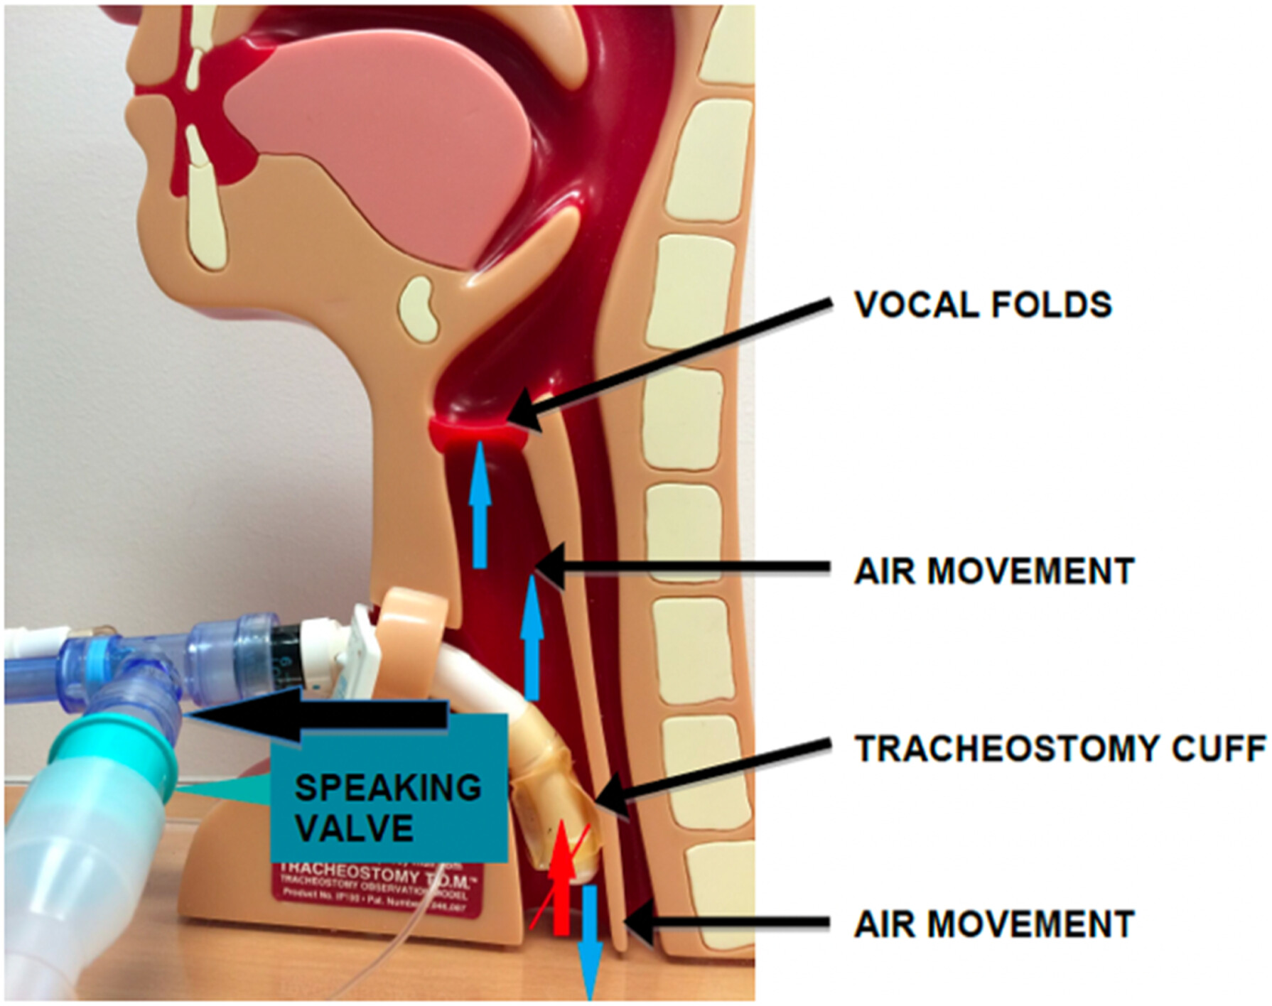

Slide 14
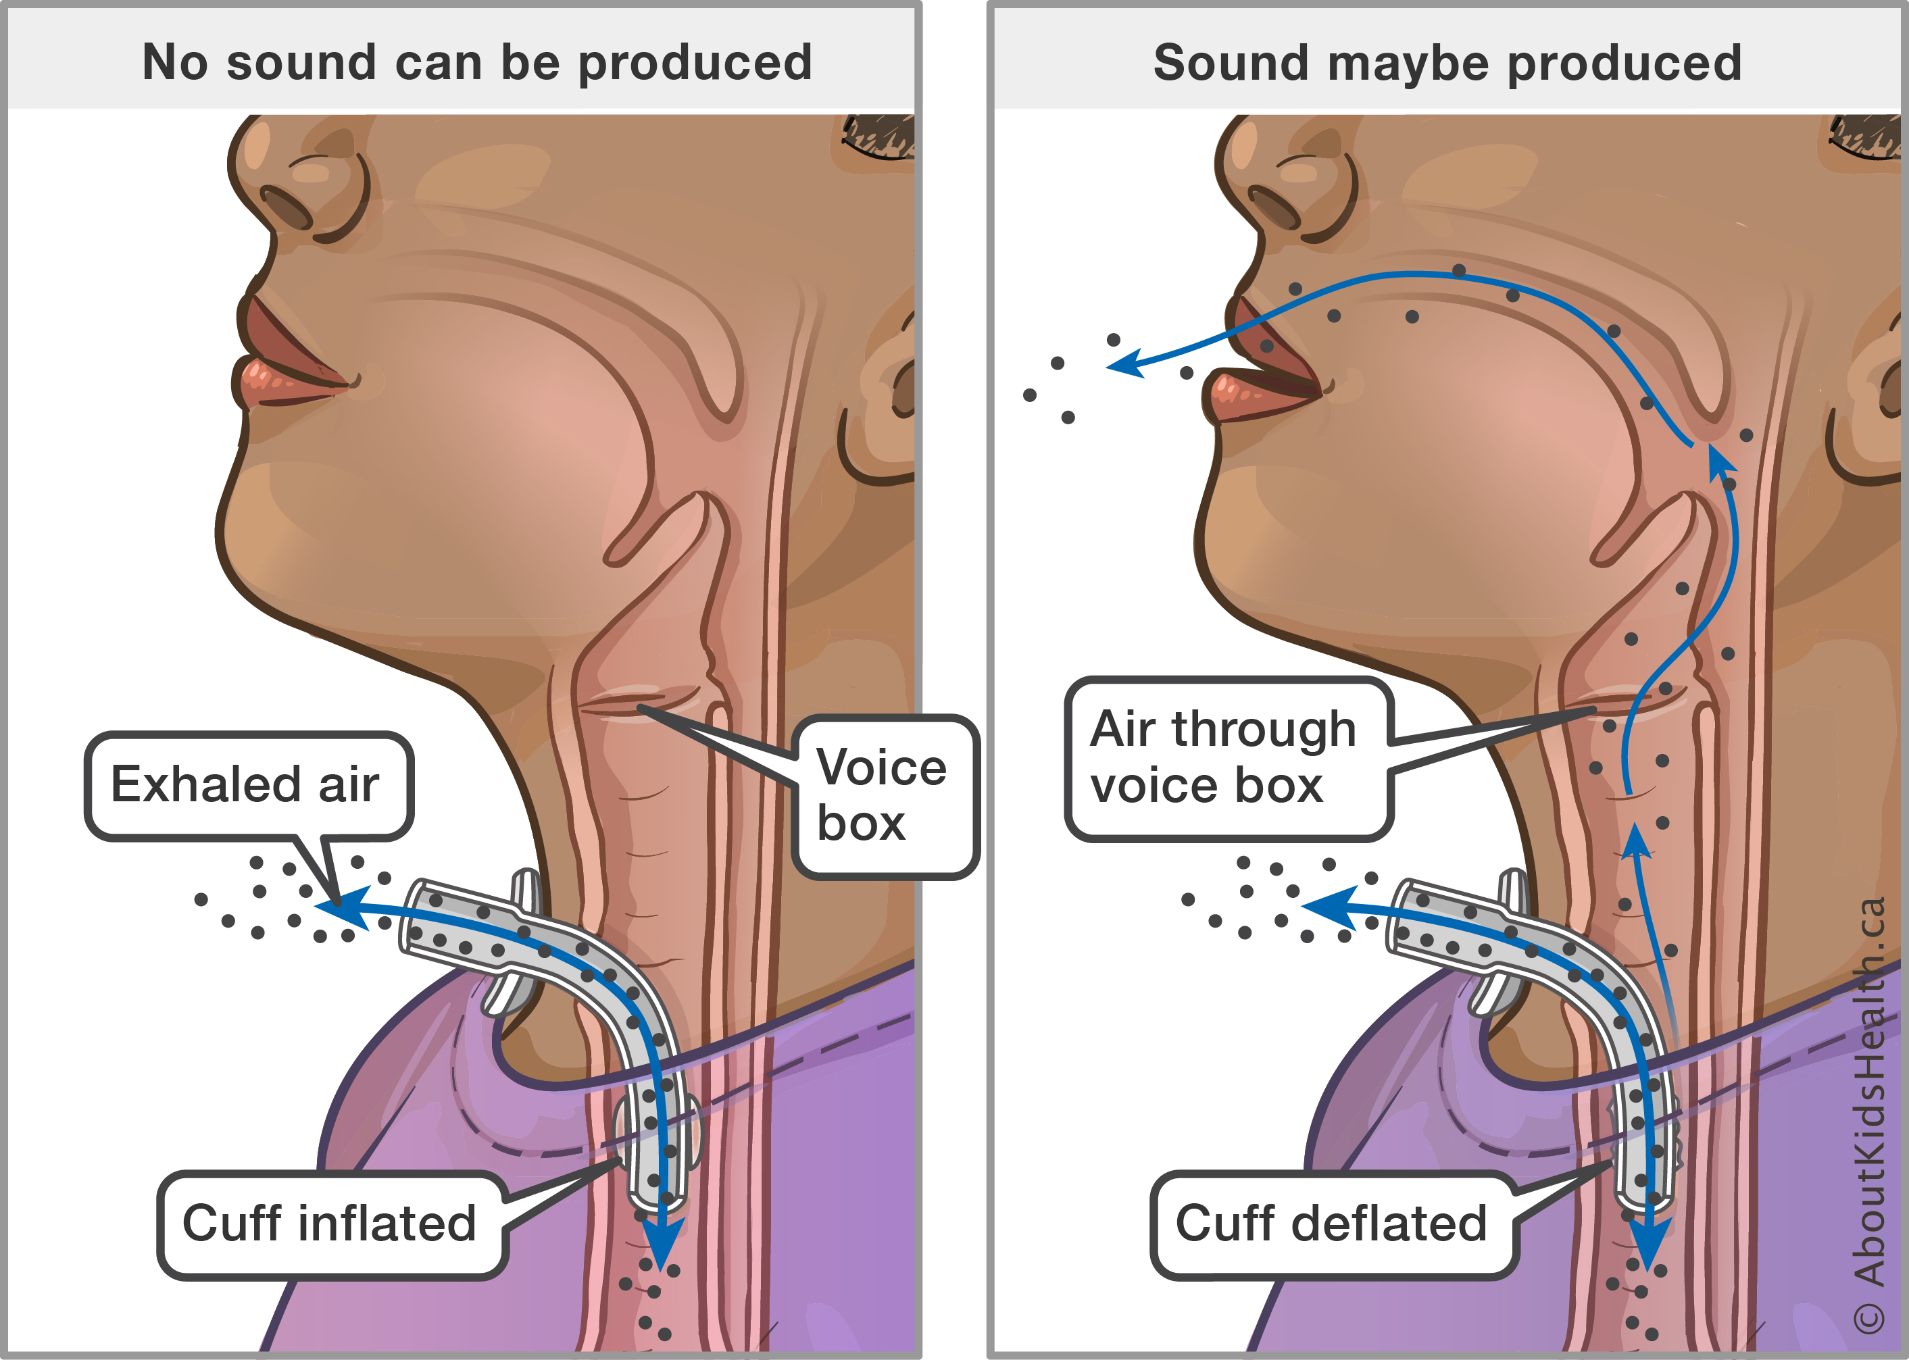

Slide 15
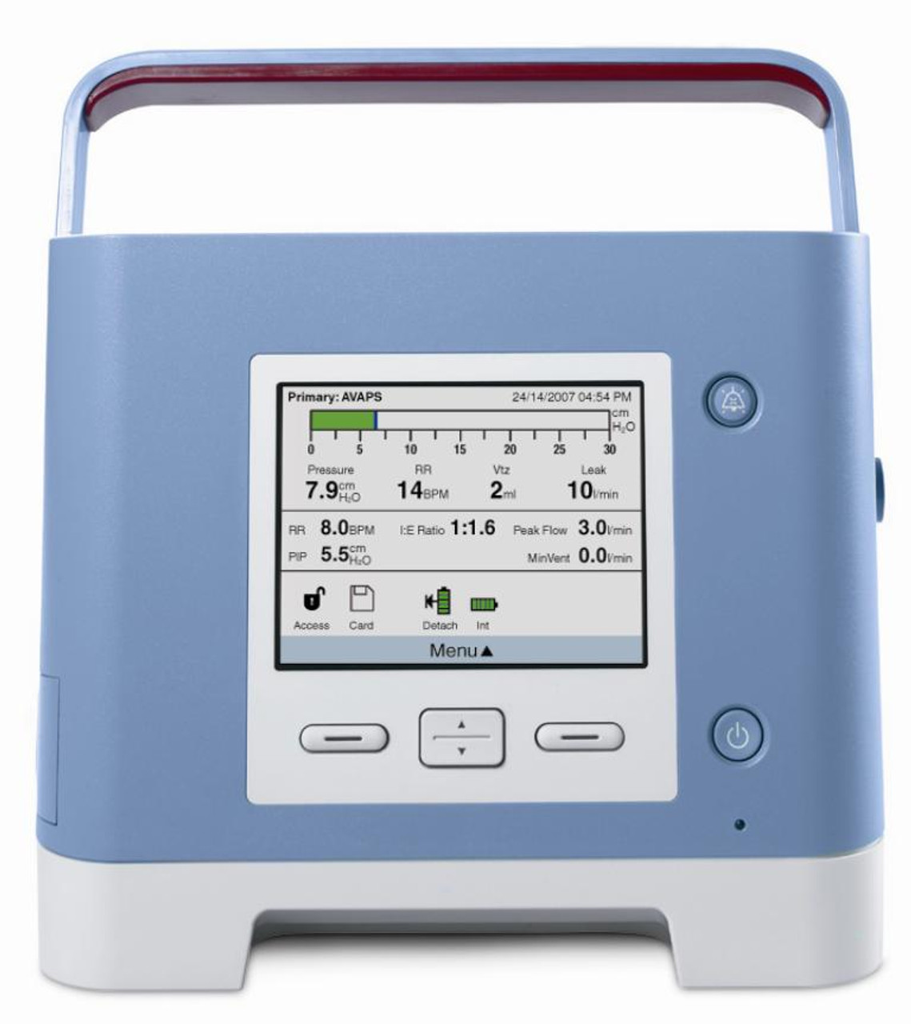
Problem solving
Safety checks:
What size is the trach?
Does it have a cuff?
Is cuff inflated?
Is there a cap or valve in place?
What to look for:
How are they breathing?
How are they sounding?
How does the tracheostomy tube look?
How is the patient feeling?

Slide 16
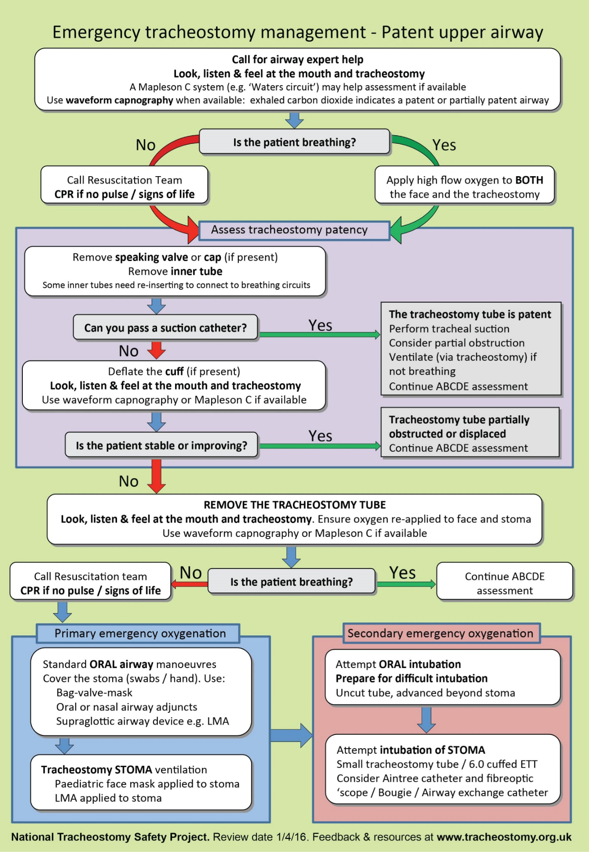
Decision tree for trach emergencies
*This is an example of a decision making tree which can be used in a hospital setting. Refer to EMS protocols/procedures for proposed emergency management.

Slide 17
[Case study removed for patient privacy]
Feel free to email julia.a.ruth@gmail.com for more information

Slide 18
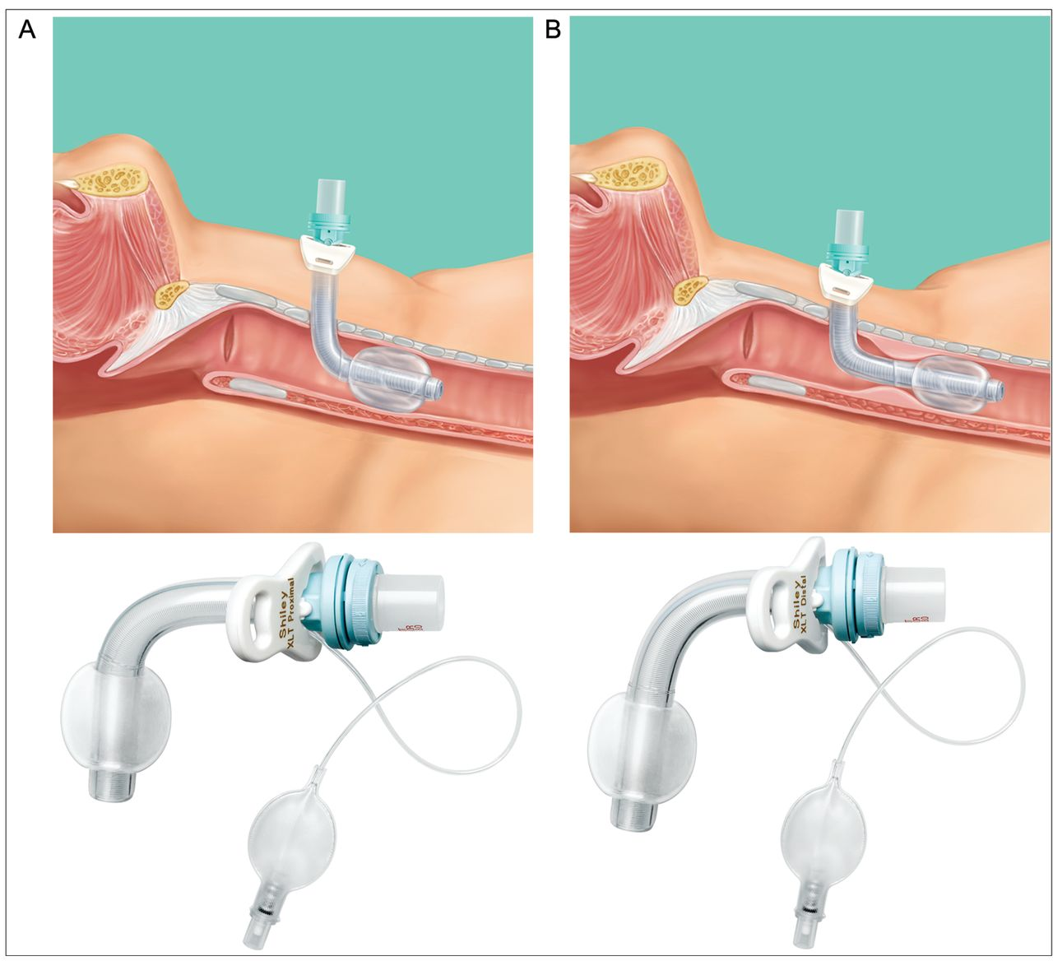
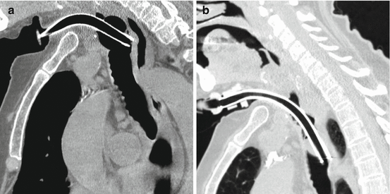
Why does trach size/position matter?

Slide 19
Questions and hands-on trach practice

Slide 20
Glossary
Chronic trach: a tracheostomy tube that a patient retains for an extended period of time or for the duration of their life
Decannulation: removal of a tracheostomy tube
HME: Heat Moisture Exchanger, a small filter system that attaches to outside of trach to act as an “artificial nose”
Mechanical ventilation: positive pressure respiratory support most frequently seen in acute care hospital setting and long term care (can also be seen in home environment)
PMV: Passy Muir Valve, a one-way valve that allows patients to vocalize with a tracheostomy tube by directing exhaled air through vocal cords (instead of out through trach)
Stoma: hole that a trach goes inside of
Trach mask: oxygen delivery via small tent surrounding trach (NOT a closed system)

Slide 21
Sources
Abril, M. K., Berkowitz, D. M., Chen, Y., Waller, L. A., Martin, G. S., & Kempker, J. A. (2021). The Epidemiology of Adult Tracheostomy in the United States 2002-2017: A Serial Cross-Sectional Study. Critical Care Explorations, 3(9). https://doi.org/10.1097/CCE.0000000000000523
Altinbaş, Y., Aslan, S., & Karaca, T. (2021). Relationships among self-care agency, health perceptions, and activities of daily living in patients after tracheostomy: A cross-sectional multisite study. Wound Management and Prevention, 67(2), 40–47. https://doi.org/10.25270/wmp.2021.2.4047
Antoniou, I., Wray, J., Kenny, M., Hewitt, R., Hall, A., & Cooke, J. (2022). Hospital training and preparedness of parents and carers in paediatric tracheostomy care: A mixed methods study. International Journal of Pediatric Otorhinolaryngology, 154. https://doi.org/10.1016/j.ijporl.2022.111058
Bontempo, L. J., & Manning, S. L. (2019). Tracheostomy Emergencies. In Emergency Medicine Clinics of North America (Vol. 37, Issue 1, pp. 109–119). W.B. Saunders. https://doi.org/10.1016/j.emc.2018.09.010
Criner, G., Make, B., & Celli, B. (1987). Respiratory muscle dysfunction secondary to chronic tracheostomy tube placement. Chest, 91(1), 139–141. https://doi.org/10.1378/chest.91.1.139
Doherty, C., Neal, R., English, C., Cooke, J., Atkinson, D., Bates, L., Moore, J., Monks, S., Bowler, M., Bruce, I. A., Bateman, N., Wyatt, M., Russell, J., Perkins, R., & McGrath, B. A. (2018). Multidisciplinary guidelines for the management of paediatric tracheostomy emergencies. Anaesthesia, 73(11), 1400–1417. https://doi.org/10.1111/anae.14307

Slide 22
Sources
Hill, C., Dickson, R., Patrick, C. (2023) Case of the Quarter: The Terrible Trach. EMS World. Case of the Quarter: The Terrible TrachCase of the Quarter: The Terrible Trach (hmpgloballearningnetwork.com)
Mehta, A. B., Walkey, A. J., Curran-Everett, D., & Douglas, I. S. (2019). One-Year Outcomes Following Tracheostomy for Acute Respiratory Failure. Critical Care Medicine, 47(11), 1572–1581. https://doi.org/10.1097/CCM.0000000000003959
Mitchell, R. B., Hussey, H. M., Setzen, G., Jacobs, I. N., Nussenbaum, B., Dawson, C., Brown, C. A., Brandt, C., Deakins, K., Hartnick, C., & Merati, A. (2013). Clinical consensus statement: Tracheostomy care. Otolaryngology - Head and Neck Surgery (United States), 148(1), 6–20. https://doi.org/10.1177/0194599812460376
Quinton, B. A., Tierney, W. S., Bryson, P. C., Bribriesco, A., Gillespie, C. T., & Hopkins, B. D. (2022). An institution-wide tracheostomy rounding team: Initial caregiver perceptions. American Journal of Otolaryngology - Head and Neck Medicine and Surgery, 43(2). https://doi.org/10.1016/j.amjoto.2021.103367
Watters, K. F. (2017). Tracheostomy in infants and children. Respiratory Care, 62(6). https://doi.org/10.4187/respcare.05366

