Slide 1
Asthma
Rama Heyratifar, MD

Slide 2
5 Time-Sensitive Critical Illnesses
Acute Respiratory Failure
Stroke
Cardiac Arrest
Trauma
STEMIs
Notes:
Acute respiratory failure (ARF) is one of the five time-sensitive critical illnesses (along with stroke, cardiac arrest, trauma, and ST elevation myocardial infarctions) where EMS intervention may likely have a significant impact

Slide 3
Acute Respiratory Failure
3 MCC:
CHF
Asthma
Chronic Obstructive Pulmonary Disease (COPD)

Slide 4
Epidemiology
Affects approximately 260 million individuals worldwide, 25 million Americans.
> 2 million ED visits annually
Death rates declining, approximately 400,000 deaths/yr
Biggest factor: Limited access to healthcare

Slide 5
Pathophysiology
Airway Inflammation
Cascading effects of IgE antibodies, cytokines, other mediators -> activation of mast cells, basophils nd subsequent histamine, prostaglandin D2, various leukotrienes, inflammatory cells including eosinophils.
Airflow Obstruction
Contraction of airway smooth muscle
Thickening of the airway wall 2/2 edema
Mucus plugging
Airway remodeling (thickening of basement membrane, deposition of collagen, shedding of epithileal cells) lead to irreversible changes to airway Bronchial hyperresponsiveness
Multiple mechanisms
Increased histamine from mast cells or increase airway smooth muscle mass
Increased vagal tone
Increased intracellular free calcium (further enhances contractility)

Slide 6
History and Symptoms
Hallmark symptoms:
Dyspnea
Cough
Wheezing
Chest tightness
Atopic triad: atopic dermatitis (eczema), asthma, allergies (rhinitis)
Significant risk factors: recent history of intubation, ICU admission.
Early recognition and intervention crucial to prevent progression to severe, life-threatening stages.

Slide 7
Physical Exam
Tachypnea
Tachycardia
Prolonged expiratory phase
Reduced air movement (false CTAB)
Conversational dyspnea
Accessory muscle use/”belly breathing”
Tripod position

Slide 8
The Goal
AVOID intubation and mechanical ventilation in these patients has significant risk for iatrogenic complications and should be avoided as much as possible.
Pneumothorax, pneumomediastinum, pneumonia, pulmonary barotrauma, shock, ICU-acquired infections.
Medical management should be optimized and mechanical ventilation should be used as a last resort.

Slide 9
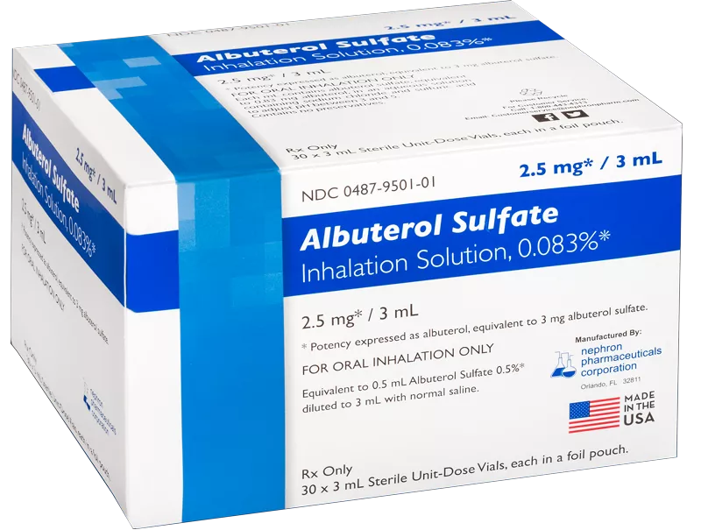
Albuterol
β2-adrenergic receptors
Bronchial smooth muscle relaxation
Inhibiting immediate hypersensitivity mediator release
particularly from mast cells
β1-adrenergic receptors
Tachycardia

Slide 10
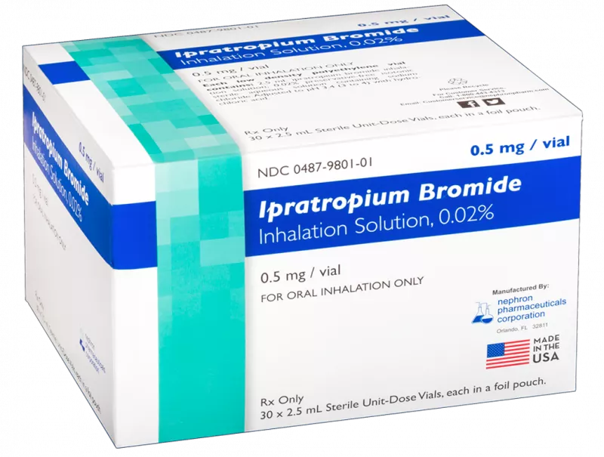
Ipratropium
Acetylcholine antagonist
Blockade of muscarinic cholinergic receptors
Decreases production of cyclic guanosine monophosphate (cGMP)
Leads to decreased contraction of smooth muscles
Also blocks M2 receptors (nonselective)
Leads to increase in acetylcholine release -> paradoxical bronchoconstriction

Slide 11
Corticosteroids
Decreases inflammation by suppression of neutrophil migration, decreased production of inflammatory mediators, and reversal of increased capillary permeability, among other mechanisms.

Slide 12
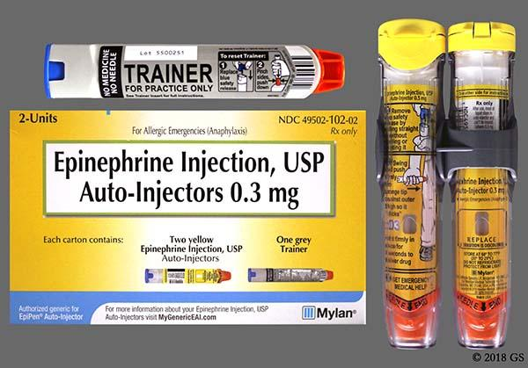
Epinephrine
Sympathomimetic catecholamine that exerts its pharmacologic effects on both alpha and beta-adrenergic receptors using a G protein-linked second messenger system
Beta-2 effects
Bronchodilation
adjunct treatment of asthma exacerbations and vasodilation

Slide 13
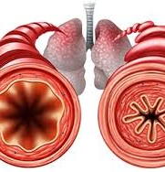
Magnesium Sulfate
Debatable additive benefit
Presumed MOA
Inhibition of calcium influx into airway smooth muscle cells
Systematic Review
14 studies, 2313 adults, acute asthma
Decrease in hospitalizations with IV vs. placebo (OR 0.75, 95% CI 0.60-0.92)
No difference in duration of ED treatment or admission to ICU
May be of benefit in subgroup of patients
PMID 24865567

Slide 14
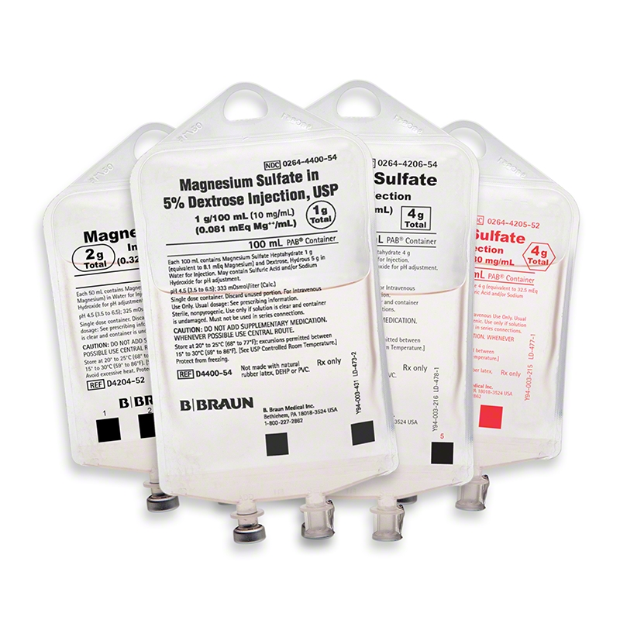
Magnesium Sulfate
Multicenter, double blinded, placebo controlled, randomized trial
1109 adults, acute asthma
IV vs. nebulized vs placebo
No benefit in decreasing hospital admission, breathlessness scoring (VAS), Peak Expiratory Flow Rates (PEFR)
PMID 24731521

Slide 15
Magnesium Sulfate, Pediatrics
Multiple meta-analyses
Effective in preventing hospitalization in children with moderate-to-severe acute asthma when added to bronchodilators and glucocorticoids
Associated with significant improvements in pulmonary function tests
PMID 15613519, PMID 27126744, PMID 23290189, PMID 29851914

Slide 16
National Asthma Education and Prevention Program, Pediatrics
NAEPP guidelines suggest 25 to 75 mg/kg (maximum 2 grams) intravenously for severe exacerbations unresponsive to initial treatments after one hour and as add-on therapy for life-threatening exacerbations

Slide 17
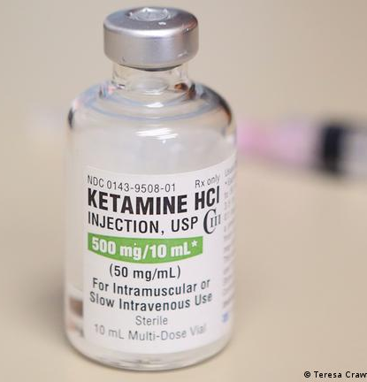
Ketamine
Rapid bioavailability through intravenous or intramuscular administration
Peak serum concentrations being achieved within 1 minute
Duration of action is approximately 10-15 minutes
Cleared hepatically with a half-life of 2-3 hours

Slide 18
Ketamine: MOA
Causes a catecholamine release that leads to relaxation of bronchial smooth muscles via beta-2 receptors
It blocks the activation of N-methyl-D-aspartic acid (NMDA) receptors in the lung parenchyma. These NMDA receptors are partly responsible for causing the bronchoconstriction found during COPD and asthma exacerbations.
Decreases the production of nitric oxide, inhibits vagal outflow, and stimulates smooth muscle relaxation by reduction of calcium influx via L-type calcium channels.
Blocks the activation of macrophages and reduces cytokine production, which decreases the inflammatory cascade and bronchoconstriction.

Slide 19
SAFD
Retrospective chart review from January 1, 2019 to July 15, 2022.
Inclusion Criteria
age ≥ 18 years, known history of asthma, presenting with respiratory symptoms, interventions that included ketamine.
Exclusion criteria
age < 18 years, did not receive ketamine, known prisoners, known to be pregnant, trauma patients, lack of post-treatment vital signs, presented in cardiac arrest, or received ketamine for purposes other than respiratory complaints

Slide 20
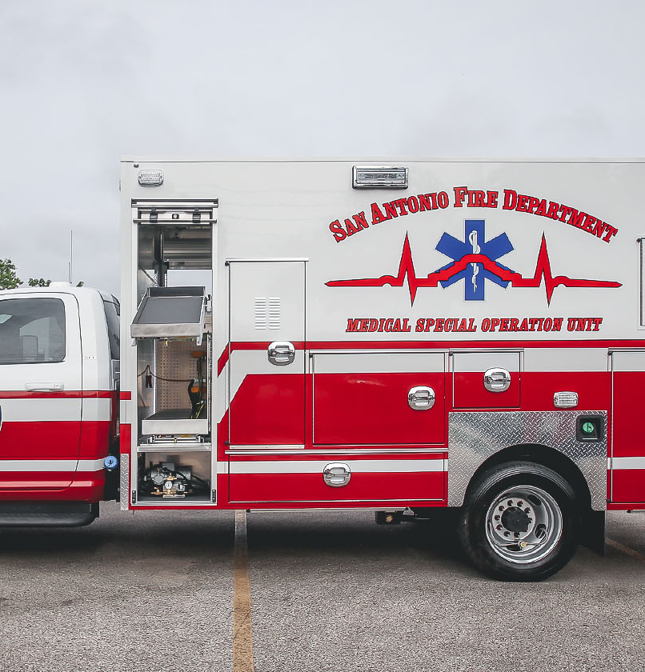
SAFD
Adverse events were defined as the need for airway management, development of apnea, vomiting, respiratory or cardiac arrest.
A descriptive analysis was performed to characterize the demographics and adverse events. Continuous variables are presented as means, standard deviations, and 95% confidence intervals. Categorical data are presented as proportions.
T-test for pre-intervention and post-intervention vital signs and symptoms were completed.

Slide 21
SAFD
There is no literature on the use of ketamine in the prehospital setting for patients experiencing an asthma exacerbations.
In these patients, the clinical operating guidelines have the paramedic initially administer 2.5 mg albuterol, 500 mcg ipratropium bromide with a glucocorticoid (12 mg dexamethasone IV, 125 mg solumedrol IV, or 60 mg prednisone PO). If symptoms persist, the guidelines recommend additional treatments including continuous albuterol, 2g magnesium sulfate over 10 minutes, positive pressure support, 0.2 mg/kg slow IV/IO/IM push of ketamine.
If the patient is having a severe asthma exacerbation and has arrested or is close to arresting, then 2 mg/kg dosing is recommended.

Slide 22
SAFD
A total of 20 patients met criteria.
Average systolic blood pressure of 148±40 mmHg before ketamine administration and 158±48 mmHg after ketamine administered (P ≥ 0.05).
Average heart rate increased 7 beats/min after ketamine P ≥ 0.05).
Pre-ketamine and post-ketamine average SpO₂ was 92.6±9.2% and 97.7±3.6%, respectively (P ≤ 0.05).
Qualitative symptom improvement were reported in 18 patients, 2 patients reported no change.
Two adverse events were noted, one patient developed emesis and one patient experienced a decreased GCS requiring transient bag-valve mask (BVM) use without the need for an advanced airway.

Slide 23
Ketamine
In the asthma group, one patient was noted to have a decreasing GCS requiring transient BVM use.
Upon further review, that patient was experiencing a severe asthma exacerbation upon the medic unit’s arrival and the patient’s GCS was decreasing prior to the 50 mg of IV ketamine administration.

Slide 24
Ketamine
Table 1: Pre-Intervention and Post-Intervention Results
 | Asthma
Sample size | 20
Age (years) | 47.1
Symptomatic improvement (%) | 90%
 | Pre-Intervention | Post-Intervention
Average systolic blood pressure (mmHg) | 148±40.2 | 158±48.7
Average diastolic blood pressure (mmHg) | 88±26.8 | 103±36.3
Average heart rate | 107±21.8 | 114±18.3
Average respiratory rate | 27±21.8 | 18±7.3
Average SpO₂ (%) | 92.6±9.2 | 97.7±3.6
Average End-tidal CO₂ (mmHg) | 40±17.2 | 33±12.4

Slide 25
Ketamine
An inherent weakness to any retrospective chart review is the lack of standardization.
All patients received the initial treatments and depending on the severity of the exacerbation, additional treatments were administered, including the use of ketamine.
The additional treatments that were administered were not standardized, nor were they given at timed intervals.
The recorded post-treatment vital signs also varied in terms of their time from ketamine administration.
Doses also varied widely between 15 mg to 200 mg depending on the patient’s clinical presentation.

Slide 26
Literature Review
Bolus dose is variable, ranging from 0.1 to 2 mg/kg with and without the use of infusions, which also vary between 0.15 to 2.5mg/kg/hr.
No optimal dosing regimen has been found.

Slide 29
Ketamine
In one study, Howton et al. performed a prospective, double-blinded, placebo-controlled clinical trial involving 44 adult patients with asthma exacerbations and found that low dose IV ketamine did not demonstrate an increased bronchodilatory effect compared with their standard therapy (oxygen, continuous nebulized albuterol, methylprednisolone sodium succinate).
The bolus dose used was 0.1 mg/kg followed by 0.5 mg/kg/hour infusion for 3 hours.

Slide 30
Ketamine
Esmailian et al. performed a single-blinded, placebo-controlled clinical trial involving 92 adult patients with asthma exacerbations and found that the effects of 0.4 mg/kg to 0.5 mg/kg doses of IV ketamine followed by infusion of the same dose over thirty minutes led to a higher increase in peak expiratory flow rates than lower doses.

Slide 31
Ketamine
The use of ketamine, like any medication, is not without its risks, but its use in the prehospital setting with close monitoring can be performed with very low rates of negative outcomes.
With ketamine’s ability to provide bronchodilation through additional mechanisms of action, we believe that early use of ketamine in the prehospital setting has the potential to provide benefit when refractory to initial therapy.
This early intervention could change the exacerbation’s trajectory, staving off mechanical ventilation.

